Slide 1

Incident Response Walkthrough
David Thejl-Clayton - @Dcsecuritydk

Slide 2




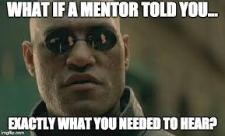
A little about me…
British living in Denmark
Cyber Defence Center Manager
Blogger
Open source
Teaching/Mentoring

Slide 3
Why do we do incident response?
Plainly we do it because we have to... The threat landscape dictates that every organization is at risk.
Center for Cyber Security threat landscape from 2020:-
Truslen fra cyberkriminalitet er MEGET HØJ. Truslen er rettet mod alle. Der er en stigende trussel fra målrettede ransomware-angreb mod danske myndigheder og virksomheder.
https://cfcs.dk/da/cybertruslen/trusselsvurderinger/cybertruslen-mod-danmark/

Slide 4
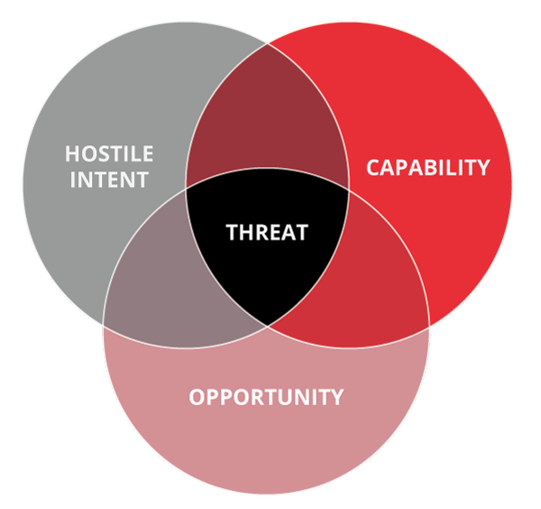
But what is a threat?
Intent: Do they have reasons to target you? Competitor?
Capability: Do they have the tooling and skills to carry it through?
Opportunity: Will they get the opening they need?

Slide 5
Where is the value in incident response?
Depending on who you ask, you will get a difference answer:-
CISO’s – Learning from our incidents, to make improvements to prevent the same mistake twice
CIO’s – Ensuring that operations aren’t impacted for too long in case of an incident
Incident Responders – Doing cool analysis and getting to be a hero
If only there was a magical way to unite all of the parties, and provide value to all of them…

Slide 6
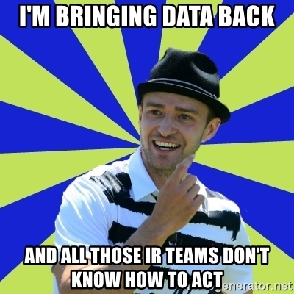
Data data data data
What if there was a way to satisfy all of the stakeholders needs…
Data is super important in incident response, and we will find out as we move through this case…

Slide 7
Exercise 1 – Security Incident
Do you know the difference between an event, security event and security incident?
Spend 10 minutes in your groups discussing each one, and write down your results in your Teams channel.
What is an event?
What is a security event?
What is a security incident?
An example: How do you classify a failed SSH login to a server in the logs?

Slide 8
Exercise 1 – Security Incident
What is an event? – An event is something that has happened and is observable.
What is a security event? – An event which is relevant to security and warrants investigation
What is a security incident? – A security event which has had an impact

Slide 9
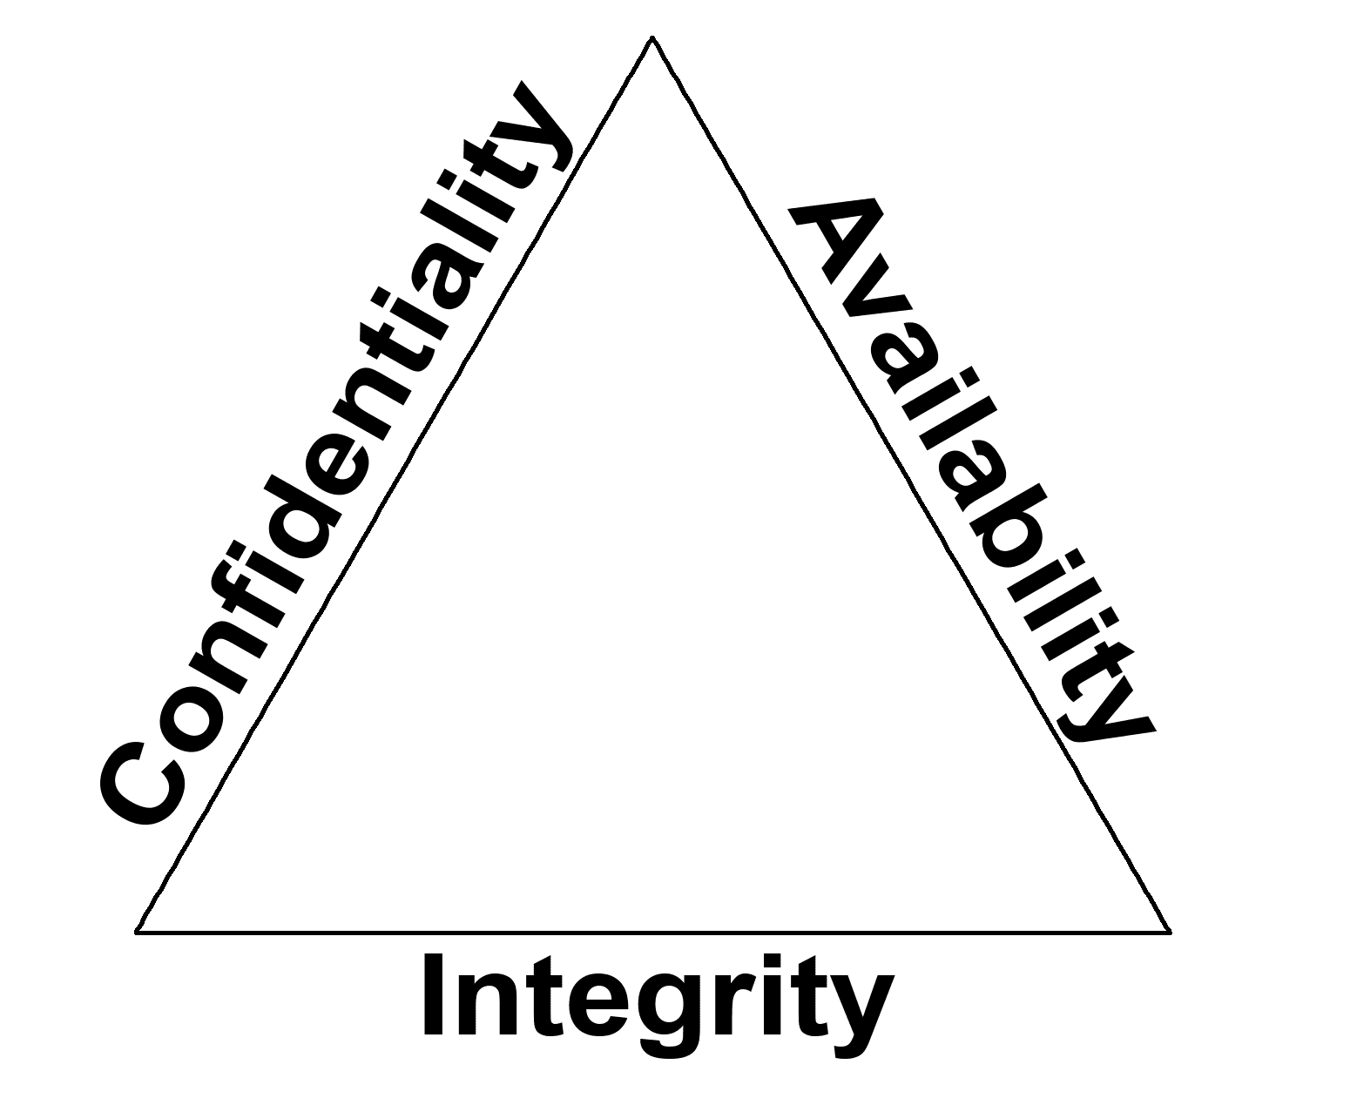
Impact
Confidentiality – Has data been compromised/leaked from the organization?
Availablity? – Has this incident resulted in downtime to a host/application/service?
Integrity – Has the integrity of the data/host/application/service been affected? Has data been manipulated?

Slide 10
Now we can finally look at our incident response process!

Slide 11
Incident Response Process 101
Stage 1
Alert
Stage 2
Visitation
Stage 3
Analysis
Stage 4
Response
Stage 5
Reporting
Acknowledge
RFI
Response actions
Communication

Slide 12

RE&CT Framework
Created by the awesome guys at Atomic Threat Coverage
Similar to the MITRE ATT&CK Framework
Incident Response contains repeatable actions
Document them
Heatmap them
Find gaps and improve
https://github.com/atc-project/atc-react

Slide 13
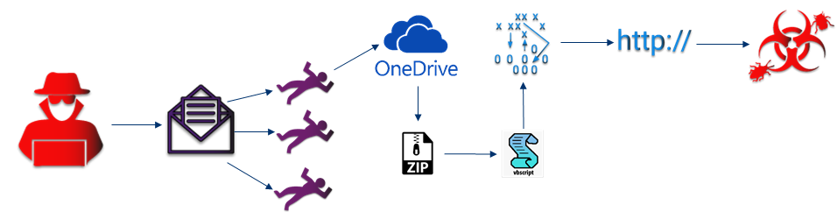
Qbot Infection
David Thejl-Clayton from the finance department recieves a mail reply as part of a previous mail correspondance with a friend. The new reply has a OneDrive link inside, they click on the link which retrieves a ZIP file to their machine, helpguide.zip. They unzip the file and it contains a file with a double extension, helpguide.docx.vbs. The file is shown by Windows to be a docx, so the user opens the file.

Slide 14
Qbot Infection
The file was actually a VBS script, which when executed retrieved some information from WMI about the OS version, AV engine etc. It then attempted to retrieve, via BITS, second stage malware from a domain, which failed due to intelligence in the proxy filter. The domain was totallylegit[.]dk

Slide 15
Stage 1 - Alert
Nearly all incidents begin with an alert that something has happened that requires further investigation.
I say nearly all, because an incident can be started via the output from a threat hunt, or via a user reporting a suspicious email into the SOC.
In this case the alert came from the corporate proxy server intelligence feed which processes HTTP logs and looked like this…
The user DTC on hostname secdis01 has communicated with a known C2 hosting malicious domain.
Time: 15/03/2021 15:54 UTC, Username: DTC, Hostname: secdis01
Domain: totallylegit.dk, Domain Category: malicious, User-Agent: BitsAdmin

Slide 16
Important point for later… The proxy server does not do HTTPS interception…

Slide 17
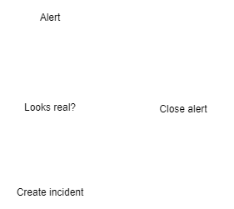
Stage 2 - Visitation
The reality is that analysis takes time and costs the business money to perform, alerting tools and detection engines like SIEM are also not always delivering true positive alerts.
This stage is for making decisions about:-
Does this alert need analysis?
Do I need more info? (user reported)
How should this alert be prioritised?
How should this alert be classified?

Slide 18
Stage 2 - Question
The user DTC on hostname secdis01 has communicated with a known C2 hosting malicious domain.
Time: 15/03/2021 15:54 UTC, Username: DTC, Hostname: secdis01
Domain: totallylegit.dk, Domain Category: malicious, User-Agent: BitsAdmin
Can anyone suggest any reasons why this alert might be false positive?

Slide 19
Stage 2 – FP or not
Things to consider:-
Quality of alert source?
Data available inside alert?
In this example it is only based on the domain name, what if this was a CDN or filesharing domain used for legitimate reasons too. This alert is also based on the vendors own intelligence feed, which could be out of date or also prone to FP.

Slide 20
Stage 2 – Decision Point
In this case, we have a user visiting a known malicious domain, especially with its relation to a known C2. We must analyze this alert further…
How should we prioritise it?
How should we classify it?
VERIS
ENISA

Slide 21
Stage 2 – Data data data
The user DTC on hostname secdis01 has communicated with a known C2 hosting malicious domain.
Time: 15/03/2021 15:54 UTC, Username: DTC, Hostname: secdis01
Domain: totallylegit.dk, Domain Category: malicious, User-Agent: BitsAdmin
time | 15/03/2021 15:54 UTC
hostname | secdis01
username | DTC
alert source | Proxy Server Logs
IOC.domain | totallylegit[.]dk
User Agent | BitsAdmin
Notes | Malicious domain visited

Slide 22
Bitsadmin
Does anyone know what Bitadmin is?
Windows Background Intelligent Transfer Service (BITS) is a low-bandwidth, asynchronous file transfer mechanism exposed through Component Object Model (COM). BITS is commonly used by updaters, messengers, and other applications preferred to operate in the background (using available idle bandwidth) without interrupting other networked applications.
https://attack.mitre.org/techniques/T1197/

Slide 23
Exercise 2 - How do we proceed?
We potentially have a host communicating to a C2 means that an attacker has got quite far in their attack.
It is our job as an incident responder to understand where should we start looking for clues/evidence to retrace the steps to find the initial infection vector.
Questions help drive the process, because they allow us to begin to come up with a plan to answer them…
In your groups again, can you come up with some questions to help us proceed?
An example question could be, is this a security incident?

Slide 24
How do we proceed?
Some questions in this incident could be:-
Is the host showing signs of C2 or is this a false positive?
Is it only one user who is infected?
How did this user get infected?
Is this a security incident?

Slide 25
Stage 3 - Analysis
Analysis is split up into 3 main parts:-
Collecting artifacts – Retrieving malicious files
Recording data – Which hosts were hit?
Analyzing data/artifacts – Analyzing the recorded data, and analyzing the malicious files

Slide 26
Stage 3 – Analysis
Analysis is quite self explanatory...
You analyze:-
Artifacts/evidence you collected
Logs and event data you may have collected before the incident
Analysis also leads to the need for further collecting and recording, the process is cyclic.
Collecting
Record
Analysis

Slide 27
Stage 3 Exercise 1
In your groups, using the RE&CT framework and information from the previous slide spend 15 minutes discussing how you would answer these two questions…
Is the host showing signs of C2 or is this a false positive?
Is it only one user who is infected?
Hint: Use both the preparation and identification section…
2nd hint: Remember your alert source ;)
time | 15/03/2021 15:54 UTC
hostname | secdis01
username | DTC
alert source | Proxy Server Logs
IOC.domain | totallylegit[.]dk
User Agent | BitsAdmin
Notes | Malicious domain visited

Slide 28
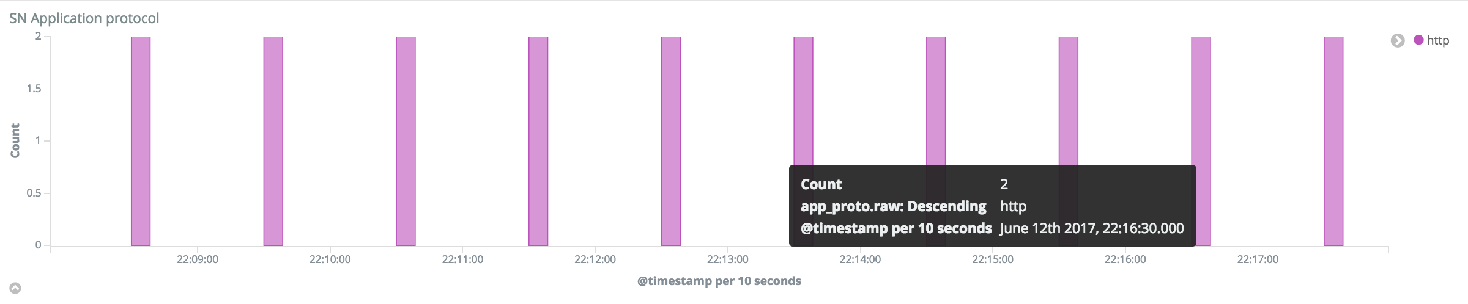
Stage 3 Exercise 1 Answers
Is the host showing signs of C2 or is this a false positive?
We know that we have access to HTTP logs and we know that the communication to the C2 is happening via HTTP as the alert came from the proxy server. So we could analyze these logs to look for telltale signs of C2 beaconing.
In this case no, there was no sign of C2, which is odd right? If the alert said so…
But it was confirmed to be BitsAdmin on the host calling out to the C2 domain.

Slide 29
Stage 3 Exercise 1 Answers
Is it only one user who is infected?
In this case you could analyze both DNS logs, or HTTP proxy logs to look for other hosts communicating with the C2 domain.
RA_2113_list_hosts_communicated_with_external_domain
In this case the answer was yes, it was only one host communicating with the external domain
Bonus question: Why might it not have been enough to rely solely on HTTP proxy logs?

Slide 30
But…
Can we for certain confirm that another user isn’t affected? If we are dealing with C2 traffic, what if there is another domain in use?
Finding out exactly how the user got infected, is key to being able to tell if another user is infected.
This is one of the pitfalls in incident response, we must take into account all possibilities..

Slide 31

MITRE ATT&CK Framework
Knowledge base of known attack vectors/patterns
Widely accepted as the industry standard for intrusion analysis
Maintained by the MITRE Corporation
How can we use MITRE ATT&CK to help us find the initial infection source?
Lets do this live on a MITRE ATT&CK layout…

Slide 32
MITRE ATT&CK - Exercise
Break up into your groups again, spend 10 minutes looking over the MITRE ATT&CK framework and discuss based on the current information we have about this alert:-
Are there any techniques or sub techniques that we can already say are being used?
If yes, which ones and why?
time | 15/03/2021 15:54 UTC
hostname | secdis01
username | DTC
alert source | Proxy Server Logs
IOC.domain | totallylegit[.]dk
User Agent | BitsAdmin
Notes | Malicious C2 domain visited
MITRE Techniques

Slide 33
MITRE ATT&CK – Exercise Answer
time | 15/03/2021 15:54 UTC
hostname | secdis01
username | DTC
alert source | Proxy Server Logs
IOC.domain | totallylegit[.]dk
User Agent | BitsAdmin
Notes | Malicious domain visited
MITRE Techniques | T1071, T1102, T1197

Slide 34
Where do we go from here?
We have 3 strong leads which we could begin investigating to get more concrete on answering our question.
Host – Should we do host forensics?
User – Should we ask the user for more information?
Domain – Should we analyze the domain further?
time | 15/03/2021 15:54 UTC
hostname | secdis01
username | DTC
alert source | Proxy Server Logs
IOC.domain | totallylegit[.]dk
User Agent | BitsAdmin
Notes | Malicious domain visited
MITRE Techniques | T1071, T1102, T1197

Slide 35
Where do we go from here?
For me the fastest and simplest approach is to start with analyzing the domain…
Host - Forensics takes a lot of time and is based on a number of things being in our favour, do we have access to the machine physically? Or do we need to wait for it to be sent to our office… Where do we start looking on the host?
User – Can we trust the user to be a source of quality information?
Domain – Finding out more information about why our proxy intelligence feed has classified this domain as malicious is going to give us far more context to narrow our investigation.

Slide 36
CTI – Cyber Threat Intelligence
“Cyber Threat intelligence is data that is collected, processed, and analyzed to understand a threat actor’s motives, targets, and attack behaviors.
Cyber Threat intelligence enables us to make faster, more informed, data-backed security decisions and change their behavior from reactive to proactive in the fight against threat actors.”
https://www.crowdstrike.com/cybersecurity-101/threat-intelligence/

Slide 37
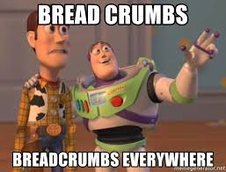
Domain - Analysis
Local CTI
Our local sharing partners, can confirm they have seen this domain used to host Qbot malware and they have seen a campaign from the sender: David@notmalicious.dk
But they are still doing their own investigation so couldn’t share anymore information.
Global CTI
Combining the information from our local CTI and the domain name, we can find that this is a very recent Qbot campaign…
Further research shows Qbot infection chain is:-
Spearphishing link via email to Onedrive, hosting .zip file. There is further mentioning of macros in office documents.

Slide 38
Data data data
Now we know the domain was also used for hosting the malware and not just for C2.
We can remove the Command and Control MITRE techniques.
But we can add some new ones in:-
T1566 – Phishing
T1204 – User execution
T1197 - BitsAdmin
time | 15/03/2021 15:54 UTC
hostname | secdis01
username | DTC
alert source | Proxy Server Logs
IOC.domain | totallylegit[.]dk
User Agent | BitsAdmin
Notes | Malicious domain visited
MITRE Techniques | T1566, T1204, T1197
Email sender | David@notmalicious.dk

Slide 39
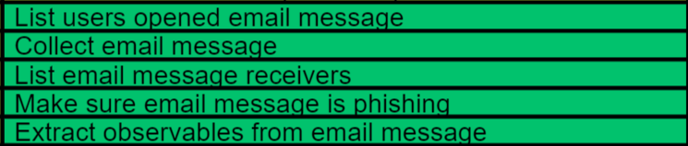
Email - Analysis
RE&CT has some good areas in relation to Email, but it is missing a basic action of being able to list mails received from a specific sender…
List mails received from specific sender:-
David@notmalicious.dk
BINGO! Subject: How is the weather?
Now we can run through the RE&CT identification actions…
List email message recievers
List users opened email message
Collect email message
Extract observables from email message

Slide 40
Wait what? Email subject is “How is the weather?”

Slide 41
Email - Analysis
After retrieving the email we can find the Onedrive link…
We also find that the email was an email thread hijack, which could explain why our user fell for the phishing attack.
Following the Onedrive link we are able to retrieve the helpguide.zip file.
Hi David,
Hope the weather in England is nice. Regards, Andrew
------
Hi Andrew,
Weather is great thanks, Regards, David
------
David find attached the file you asked me for recently: onedrive.com/helpguide.zip

Slide 42
Data data data
time | 15/03/2021 15:54 UTC
hostname | secdis01
username | DTC
alert source | Proxy Server Logs
IOC.domain | totallylegit[.]dk
User Agent | BitsAdmin
IOC.url | onedrive[.]com/helpguide.zip
Notes | Malicious domain visited
MITRE Techniques | T1566, T1204, T1197
Email sender | David@notmalicious.dk
Email subject | How is the weather
IOC.filename | helpguide.zip

Slide 43
File - Analysis
Now that we have the file which seems to have caused all of the trouble, we need to analyze it to look for evidence of what it was doing on the host, also to find possible backup malware hosting domains or C2 domains.
Unzipping the file results in us finding a visual basic script masquerading as a docx.
helpguide.docx.vbs
Dynamic Analysis – Sandboxing
Static Analysis – Reverse Engineering
In this case which makes the most sense?
Use static analysis to check for obfuscation, if none then continue.
Else use Dynamic…

Slide 44
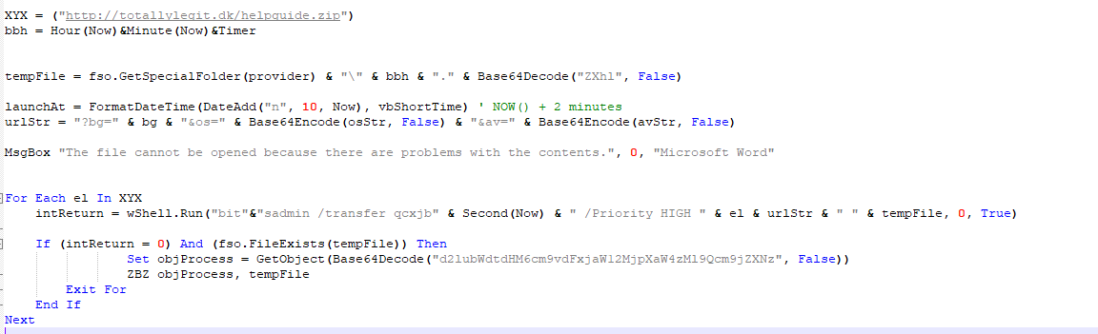
File - Static Analysis
The code is not obfuscated and is incredibly simple.
Makes some queries to WMI to ask for OS version, AV vendor and a few other parameters.
Then uses these to request the relevant payload from totallylegit[.]dk

Slide 45
Interesting decision point…
Now we have the 2nd stage payload url, we could retrieve the malware and begin analysis to look for more interesting evidence…
But…
We know that the communication to the payload hosting domain was blocked by the proxy server, and we do not have any further domains to worry about…
What would you do?

Slide 46

My decision…
Based on all the factors, and that we know this is a more generic malware family campaign.
I would choose to retrieve the malware, but not perform analysis as part of this incident. As written earlier, incident response requires fast action and is also expensive.
We need to make the differentiation between need to have and nice to have.
Further analysis within the incident would only impede the speed to response, and therefore should be left till after the incident is closed.

Slide 47
Data data data
time | 15/03/2021 15:54 UTC
hostname | secdis01
username | DTC
alert source | Proxy Server Logs
IOC.domain | totallylegit[.]dk
User Agent | BitsAdmin
IOC.url | onedrive[.]com/helpguide.zip
Classification | Malware, Social Engineering
MITRE Techniques | T1566, T1204, T1197
Email sender | David@notmalicious.dk
Email subject | How is the weather
IOC.filename | helpguide.zip
IOC.hash.md5 | 63a5f69f39278ec080b94314a6e2df94
IOC.filename | helpguide.docx.vbs
IOC.hash.md5 | 721fa9844433102021aa0f693efa8468
You will notice that after performing static analysis we were able to update the data table with hash values for the files we were working with…
The notes section has been removed and replaced with the classification section. This is highly relevant for Stage 5, which we will come to later…

Slide 48
What next?
Have we answered our questions from earlier?
Is the host showing signs of C2 or is this a false positive? No
Is it only one user who is infected? Yes now we know it was only one domain
How did this user get infected? Via email
With all of the data collected, and knowing that the malware was not successful at retrieving 2nd stage, lets close down our analysis and move to response!

Slide 49
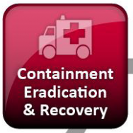
Stage 4
Stage 4
Response
It is funny that the actual response within incident response actually comes quite late in the process.
Response is split into a few parts:-
Containment – Stopping and preventing further compromise
Eradication – Removing the malicous artifacts to prevent future compromise
Recovery – Bringing the host or organization back to the previous state before the incident

Slide 50
Stage 4 – Quick note
Just because the process is set in “stages” does not mean that you have to wait until you have gathered all evidence before you can begin containment.
In some cases it is very useful to lockout a user, or isolate a host whilst running an investigation.
Stage 3
Analysis
Stage 4
Response

Slide 51
Stage 4 - Exercise
In your groups, spend 15 minutes using the data table from the Analysis round.
From this data, decide which artifacts might warrant earlier containment than others and why?
Then discuss which actions from the RE&CT framework you would use and why?
Bonus – Can you also describe which actions might have a larger impact to the business and why?

Slide 52
Stage 4 - Exercise
time | 15/03/2021 15:54 UTC | Actions
hostname | secdis01
username | DTC
alert source | Proxy Server Logs
IOC.domain | totallylegit[.]dk
User Agent | BitsAdmin
IOC.url | onedrive[.]com/helpguide.zip
Classification | Malware, Social Engineering
MITRE Techniques | T1566, T1204, T1197
Email sender | David@notmalicious.dk
Email subject | How is the weather
IOC.filename | helpguide.zip
IOC.hash.md5 | 63a5f69f39278ec080b94314a6e2df94
IOC.filename | helpguide.docx.vbs
IOC.hash.md5 | 721fa9844433102021aa0f693efa8468

Slide 53
Stage 5
For an organization, Stage 5 is where the real value from incident response is driven…
In Stage 4 the focus is on bringing the organization back to the state they were in before the incident happened. But in Stage 5 you have the chance to make a difference and improve things for the future.
This is done via:-
Incident response reporting
Lessons learned
Long term IR reporting data collection

Slide 54
Where should we concentrate our user awareness training this year?
(Governance team)

Slide 55
Stage 5 - Exercise
In your groups, create a basic incident response report on the data that has been collected in this case.
The incident response report must contain:-
Executive summary
Results of analysis
Actions which were performed
Recommendations for recovery
Recommendations for future prevention

